Slide 1
Report of the Marine Spatial Data Infrastructures Working Group (MSDIWG) to IRCC10

Slide 2
Security and Integrity
Security
Unauthorised use (e.g stealing a car, downloading a pirate movie)
To demonstrate “authorised use” some form of “permission” is required.
Integrity
Who sent me this? Is it complete?
Different from “is it correct?”
Different concepts.
In MSDI often integrity has a higher priority than security.
Why? Because often MSDI is built with the express purpose of promulgating data so most (not all) use is “authorised”
The conclusion we came to was the issue is “integrity” which relies on two things, knowing who a piece of data came from and the knowledge that it has not changed in its journey to the end user. This is also dealt with by IHO S-63 in the form of its digital signatures.

Slide 3
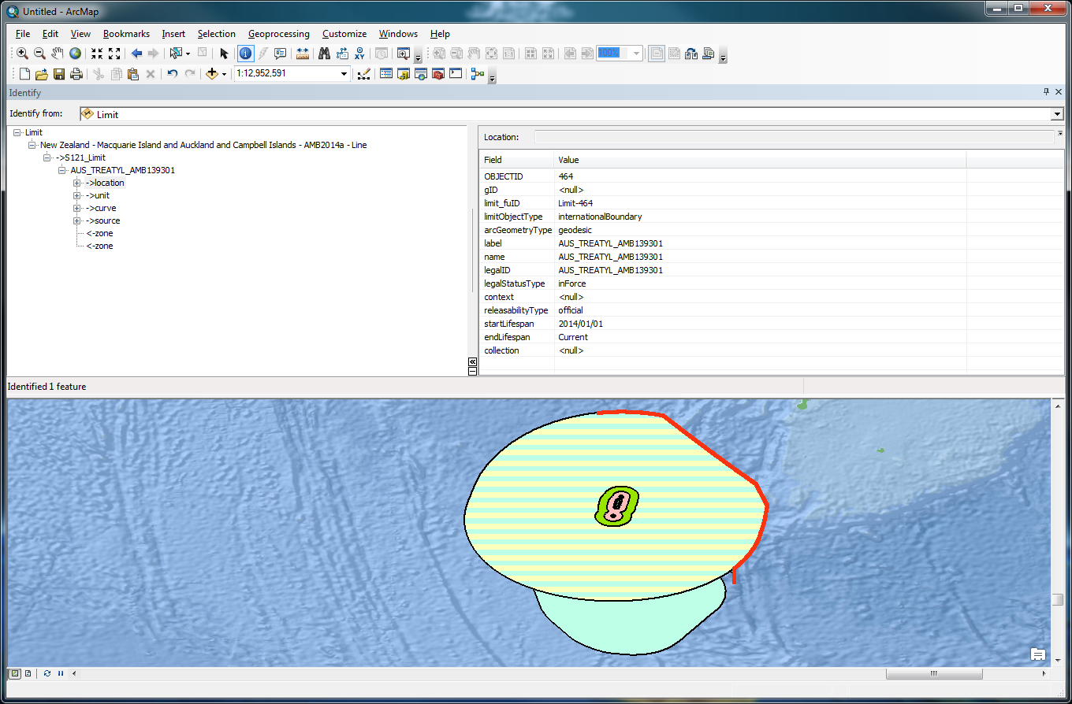
Security and Integrity - The issue within the MSDI community
Where are the risks?
Much MSDI data relates to boundaries, administrative, legal, cadastral etc.
Impact of incorrect reproduction or attribution can be very large.
Is there a ready-made solution?
Ongoing need to consider this issue
Consider existing mechanisms
Stream based may not be suitable for “data centric” models
IHO S-63 relies on a specific end user system
Other standards exist but may need adaptation
All require a “trust network” to define identitiy.
Consider that one of the fundamental datasets recently under consideration are UNCLOS maritime limits and boundaries. These datasets are simple, by comparison with the complex geospatial data which make up ENC but their economic and political weight are enormous and the impact of their incorrect reproduction through an MSDI environment is of concern.
UNCLOS official limits and boundaries are often promulgated alongside other official boundaries such as marine protected areas, fishing zones and many others which define rights and responsibilities as part of a harmonised marine cadastral system.
The challenge, technically, is to provide means and mechanisms to protect the data integrity and assure the end user of the provenance of the data they are receiving.
Notes:
Example Treaty Limit
Red is treaty

